Slide 1
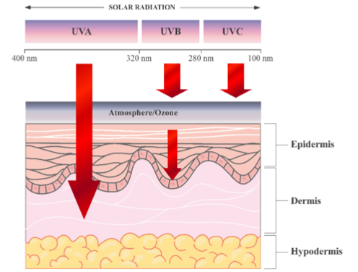
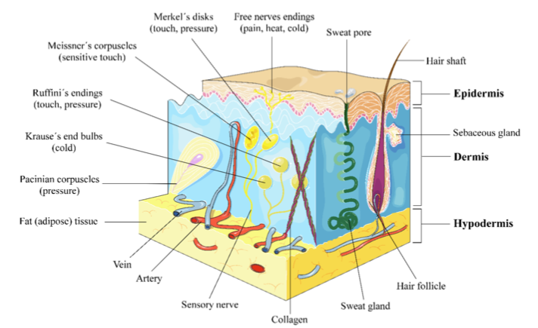
MINISTRY OF HEALTH OF UKRAINE
NATIONAL UNIVERSITY OF PHARMACY
JUSTIFICATION OF THE FEASIBILITY OF THE DEVELOPMENT OF A SKIN CARE TOOL
Kushneryk O., Oliinyk S.
Introduction
The skin is the body’s largest organ, representing one sixth of the total body weight, and its main role is to act as a chemical and physical barrier to protect the body against harmful external environmental agents such as pathogen, ultraviolet (UV) radiation exposure, chemical threats, temperature changes and even dehydration. The skin is composed of three main layers with different underlying structures: (a) the epidermis, (b) the dermis and (c) hypodermis or subcutaneous tissue (Figure 1).
UV exposure is a major causative factor for age-related changes including inflammation, degenerative ageing, ECM degeneration and cancer. UV radiation is divided into long wave UVA (320–400 nm), medium wave UVB (280–320 nm), and shortwave UVC (100–280 nm), which is absorbed by the ozone layer.
UVB represents only 0.3% of the sun’s emission reaching the ground, and UVA radiation reaches Earth surface almost entirely. UV penetrates the skin in a wavelength-dependent manner. UVA (longer wavelength) reaching the dermis and UVB is almost entirely absorbed by the epidermis (Figure 2).
Conclusions. In view of the above material, it is advisable to develop the composition and technology of a body skin care product with comprehensive preventive actions.

